Slide 1
Mathematical Discourse: An Example
Kevin McLeod
University of Wisconsin-Milwaukee
LearnDeep Collab Lab, October 9, 2017

Slide 2
Learning Intentions and Success Criteria
We are learning how mathematical discourse can help us to engage students in reasoning and problem-solving.
We will be successful if we can identify concrete mathematical discourse practices that we will begin to integrate into our teaching.

Slide 3
Chocolate and Cream
A candy factory has a large vat into which workers pour chocolate and cream. Each ingredient flows into the vat from its own special hose, and each ingredient comes out of its hose at a constant rate. Workers at the factory know that it takes 20 minutes to fill the vat with chocolate from the chocolate hose, and it takes 15 minutes to fill the vat with cream from the cream hose. If workers pour both chocolate and cream into the vat at the same time (each coming full tilt out of its own hose), how long will it take to fill the vat?
Before you find an exact answer to this problem, find an approximate answer—or find a range, such as “between…and…minutes.”
Explain your reasoning.

Slide 4
Connecting to CCSSM
Look through the Common Core State Standards for Mathematics (http://www.corestandards.org) and determine which standards for content and mathematical practice match this task.

Slide 5
Common Core Standards for Mathematical Practice
Make sense of problems and persevere in solving them.
Reason abstractly and quantitatively.
Construct viable arguments and critique the reasoning of others.
Model with mathematics.
Use appropriate tools strategically.
Attend to precision.
Look for and make use of structure.
Look for and express regularity in repeated reasoning.

Slide 6
Research on Teaching developmental Mathematics
(Givvin, K., Stigler, J., & Thompson, B., What Community College Developmental Mathematics Students Understand about Mathematics, Part 2: The Interviews, MathAMATYC Educator, Vol. 2, No. 3, May 2011),

Slide 7
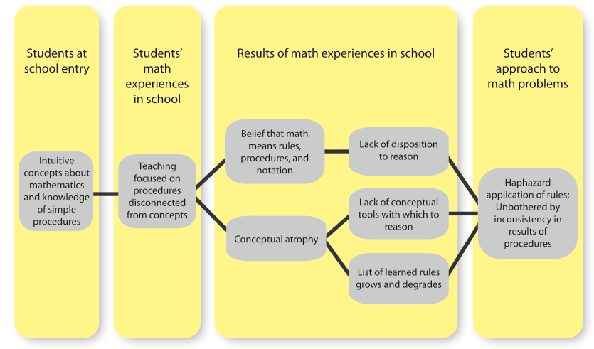
(Givvin, Stigler & Thompson, p. 6)

Slide 8
Remedying the Problem
“The goal of much of developmental math education appears to be to get students to try harder to remember the rules, procedures, and notations they’ve repeatedly been taught. … We propose a solution with three elements, each of which is necessary for success.”
(Givvin, Stigler, & Thompson, p.14)

Slide 9
Three Elements for Success
Reawaken students’ natural dispositions to figure things out & that this is what it means to do mathematics
Convince students to think by providing them productive things to think about
Reintroduce properties into the curriculum after laying the foundation of powerful concepts
(Givvin, Stigler, & Thompson, pp.14-15)

Slide 10
Learning Intentions and Success Criteria
We are learning how mathematical discourse can help us to engage students in reasoning and problem-solving.
We will be successful if we can identify concrete mathematical discourse practices that we will begin to integrate into our teaching.

